Slide 1


KS3
Study Skills
2022
Today we will be looking at:
Top tips for studying
How to actually do it!
Use of different revision techniques
Memory techniques
Making a study timetable
Notes:
Please be encouraging…. Remember they are STUDY skills – it doesn’t matter that they’ve done their exams. They should be getting their exam results/papers/PLCs and then they can use these skills/techniques to improve as soon as possible and not leave it all til the end of Year 11.

Slide 2
Top 10 Tips….
Start revising early – putting it off will just make things worse.
Make a revision timetable and stick to it!
Take short breaks — every hour, not every 10 minutes! Get yourself drinks and snacks at the start so you don't make excuses to stop every 10 minutes...
Use your revision guides – and if you haven’t bought them yet do it quick!
Find the right environment to revise, somewhere quiet where you’ll be left alone is usually best and sit at a proper desk or table – sitting on a sofa or bed makes you feel sleepy.
Notes:
Discuss these with them one by one

Slide 3
6. Don't spend ages making your notes look pretty – they need to be neat and legible but hours of making sure you’ve used every single coloured pen is a waste of time!
7. Don't just read your notes – revision needs to be active – DO something!
8. Stick revision notes/Flash cards all around your house so in the exam you think — "aha, quadratic equations, they were on the fridge...” (or behind the toilet door....?)
9. Do lots of practice exam papers – ask your teachers if there practice exam questions they can send you prior to the end of year exam.
10. And finally….. Don't turn yourself into a revision zombie! Revision is important but you have to give yourself rewards and breaks. You can still make time to socialise with friends or play your favourite computer game if you build it into your revision timetable – it’s all about planning and compromise!

Slide 4

Revision Timetables
List all of the subjects that you do and break them down into sub-categories – e.g. English Literature may be broken down into the different books you are studying and then further into chapters/themes/quotes etc. You could choose to colour code them if that helps you.
Mix your subjects up – don’t do all of your worst subjects on the same day!
Decide which things you only need a short time on and which things you need to look at for longer or several times. Basically your strengths and weaknesses – look at your topic list/PLCs!
Make a note of important things such as birthdays, family events etc. It’s ok to make time for them!
Build in breaks –10 minutes for every hour of work is usually a good rule but if you have a short concentration span maybe 5 minutes every half an hour is better.
Do a new copy for each week – that way you can cross things off as you go which will give you a sense of accomplishment.
Notes:
Go through the points, then show them the example on the next page

Slide 5
Example....
 | Monday | Tuesday | Wednesday | Thursday | Friday |  | Saturday | Sunday
4.00-5.00 (with 10 min break) | Maths - Algebra | ICT - keywords | History - Germany | Science Biology – Food chains | Night Off | 9.30 – 10.30 (with 10 min break) | English Literature | Maths - shape
5.00-6.00 (with 10 min break) | English - Shakespeare | French - vocab | ICT | Geog - tourism |  | 10.30 – 11.30 (with 10 min break) | Science Physics - Elec | English – practice exam
6.00-6.30 | Dinner | Dinner | Dinner | Dinner |  | 11.30-4.30 | Socialise with friends, spend time with family etc
6.30-7.30 (with 10 min break) | Science Physics - Forces | Maths - Trig | French - reading | History - Medicine |  | 4.30-5.30 (with 10 min break) | Maths – practice paper | Science Chemistry – Atoms / etc
7.30 – 8.15 | TV/computer | English - poetry | TV/computer | ICT – practice paper |  | 5.30 – 6.30 (with 10 min break) | History - Germany | Geog – Hostile worlds
8.15 – 9.00 (with 5 min break) | Geog - coasts | Science Chemistry – Acids/Bases | Maths - Pythagoras | French |  | 6.30- onwards | Do some reading, watch TV, have dinner etc. and put in more revision if you feel you need to
You decide on the timings so that they suit you and your family
Notes:
The timings in the grey columns can be made by them – depending on the time they get home, the time they eat, go to bed etc. Also if they go to some kind of club/activity (football, swimming etc) they can put that in.

Slide 6
Make your own! (Do it in pencil!)
 | Mon | Tue | Wed | Thurs | Fri |  | Sat | Sun
Notes:
Give them a blank copy to try – they might need some help!

Slide 7
Exam Conditions
Silence at all times in the exam room.
Mobile phones and smart watches switched off and in your bag.
Do not leave your seat.
Raise your hand to speak to your teacher – wait until they have come to your desk to speak.
No turning round or making contact with other students.
No revision materials in pockets or on the desk.

Slide 8
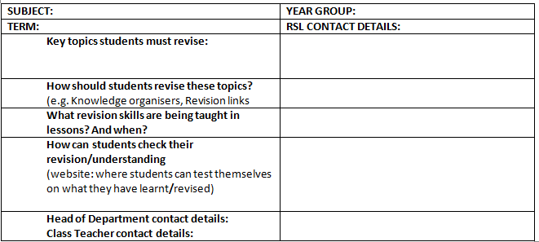
Subject revision map

Slide 9

How do you study? What are your best techniques and tips?
Notes:
Discuss what techniques they use at the moment and how they find them, how does the technique work? Can they give each other advice or tips? What do they find hard? Make them realise that it’s ok to find it difficult or not really know what you’re doing.

Slide 10
Revision lesson structure
Identify
Recognise
Transfer
Memorise
Test/
Practise
Step 1:
Mind Map (or Brain Dump) to see what they know without any revision material
Step 2:
Following this process, use PLC/topic checklist sto identify/RAG rate the topics they need to revise.
Step 3:
Students transfer new key facts, key words, processes, definitions from revision material to flash cards.
Revision material:
knowledge organisers GCSE revision books/ subject booklets
Step 4:
Students memorise the information – using the flash cards
Step 5:
Use the same test in Step 1 to see how much you’ve learnt
Retrieval practice
Interleaving, Elaboration and Worked examples
Spaced practice
Notes:
Elaborate on each step a little bit – however the next few slides will go over specific techniques (flash cards, mindmaps, memory techniques etc). They have had an assembly on this you just need to consolidate it.

Slide 11
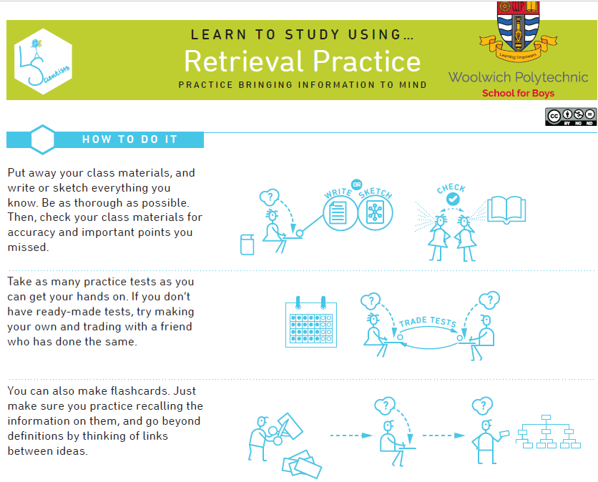
Notes:
Discuss what techniques they use at the moment and how they find them, how does the technique work? Can they give each other advice or tips? What do they find hard? Make them realise that it’s ok to find it difficult or not really know what you’re doing.

Slide 12
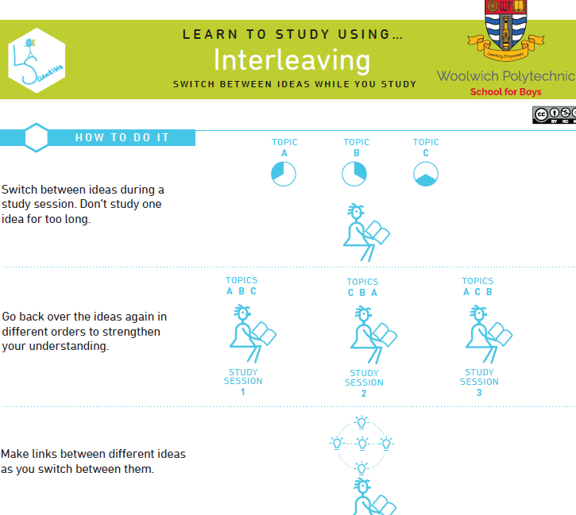
Notes:
Discuss what techniques they use at the moment and how they find them, how does the technique work? Can they give each other advice or tips? What do they find hard? Make them realise that it’s ok to find it difficult or not really know what you’re doing.

Slide 13
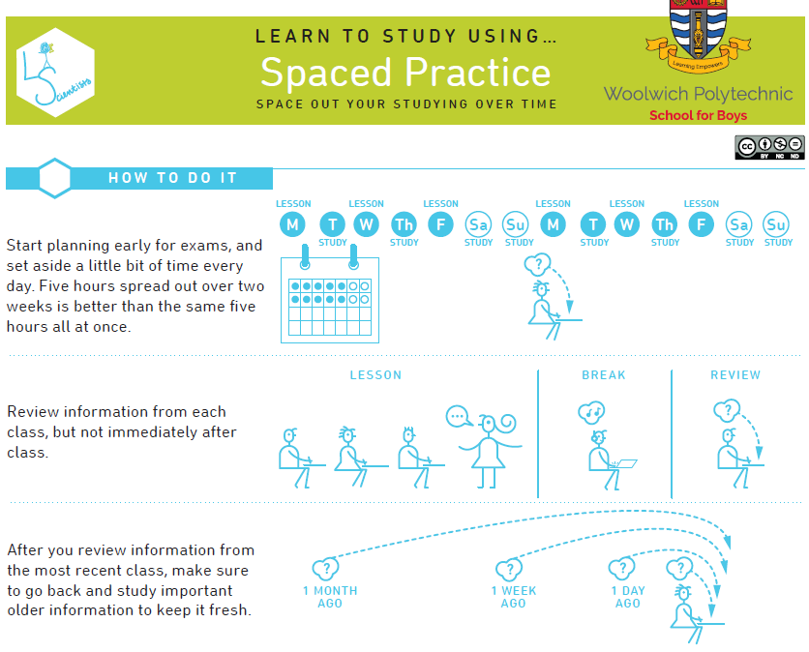
Notes:
Discuss what techniques they use at the moment and how they find them, how does the technique work? Can they give each other advice or tips? What do they find hard? Make them realise that it’s ok to find it difficult or not really know what you’re doing.

Slide 14
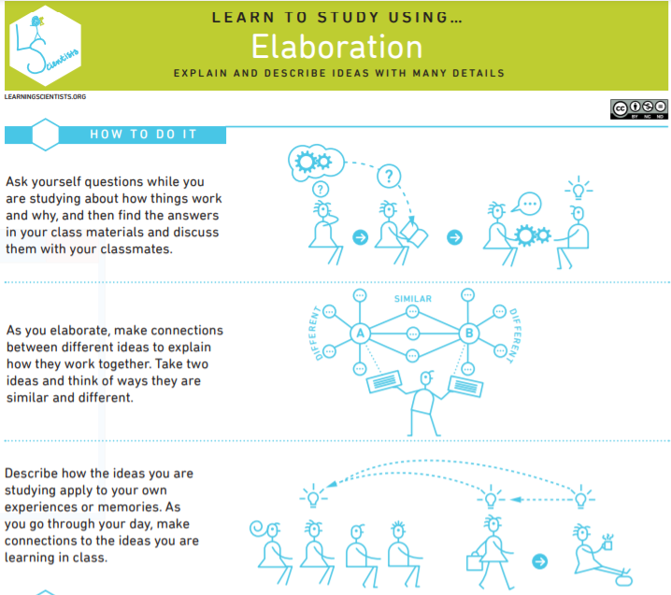
Notes:
Discuss what techniques they use at the moment and how they find them, how does the technique work? Can they give each other advice or tips? What do they find hard? Make them realise that it’s ok to find it difficult or not really know what you’re doing.

Slide 15

Revision lesson structure
Identify
Recognise
Transfer
Memorise
Test/
Practise
Revision Guide + Produce the flash Cards
Mind map:
How much do you know?
PLC/topic checklist
Use the flash cards
Mind Map
From Step 1: How much did you learn?

Slide 16
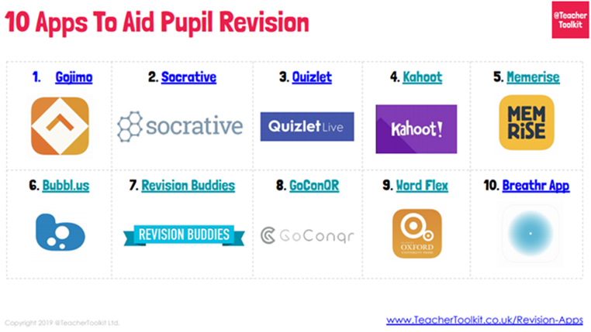
Step 4 & 5 – Memorise
(test, test, test!)

Slide 17
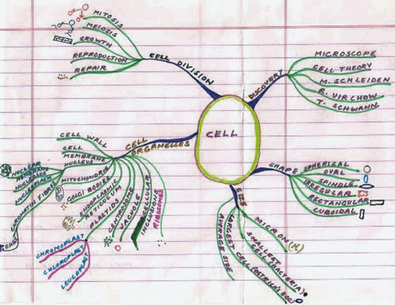
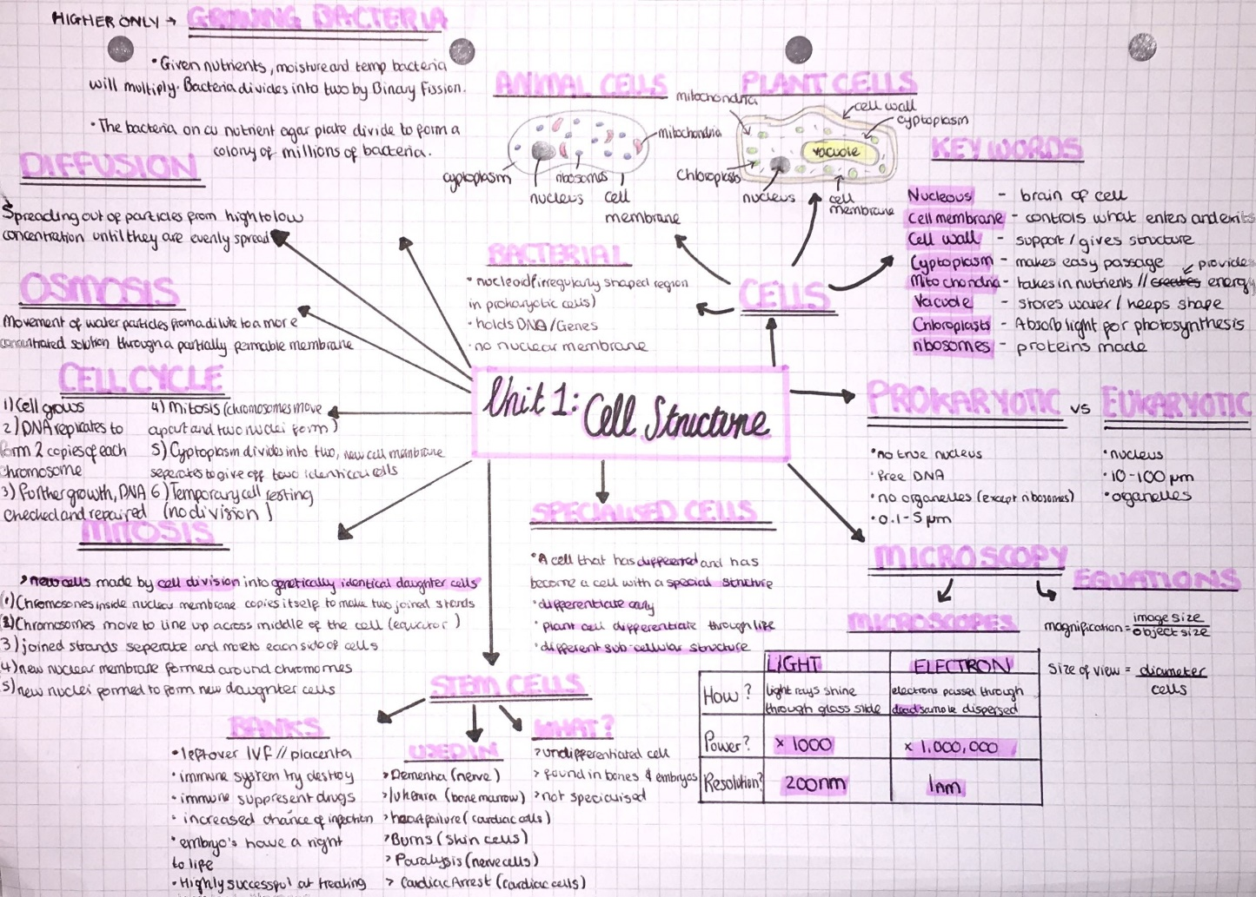
Tip: Revise another topic before attempting this again!
Step 1 & 5 - Test!
After their revision, students reproduce their mind map. They don’t look at any revision material including their flash cards. How much do they remember?
Step 1: Before
Step 5: After
Notes:
Then get students to recreate a mind map without any resources.

Slide 18
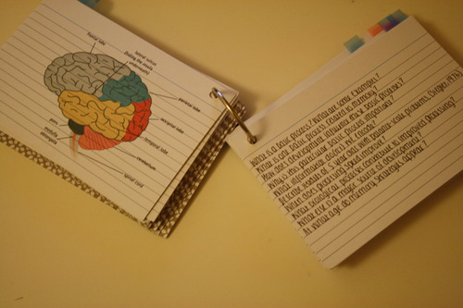
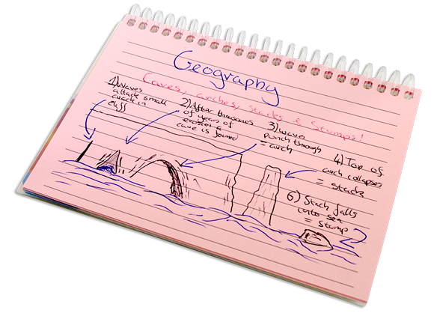
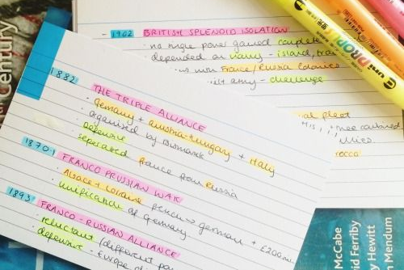
Some examples…
Make sure there is a testing effect!

Slide 19

Flash Cards!
How do they work?
Following Step 1 & 2 of the Poly revision structure, use the flash cards and write down a key topic.
For each topic write down the key sub-topics or key words.
Try to use as few words as possible to record the key points for each topic.
These are great for the day before the exam and even the morning of the exam to help you just jog your memory and go over your knowledge again.
Remember when you create your flash cards that you must have a testing effect: Question on one side, the answer on the other side.
They are also good to use for other people to test you.
They can then also be used and pinned around the house to jog your memory as to the key issues with each topic.
Try it now for the mind map you did
Watch this
https://www.youtube.com/watch?v=mzCEJVtED0U
Notes:
Explain it, then give them one flash card each to try and condense their mind map on to it. They might need to have more than one go at this.
Only give them 10 mins to do it or you’ll be there forever!

Slide 20
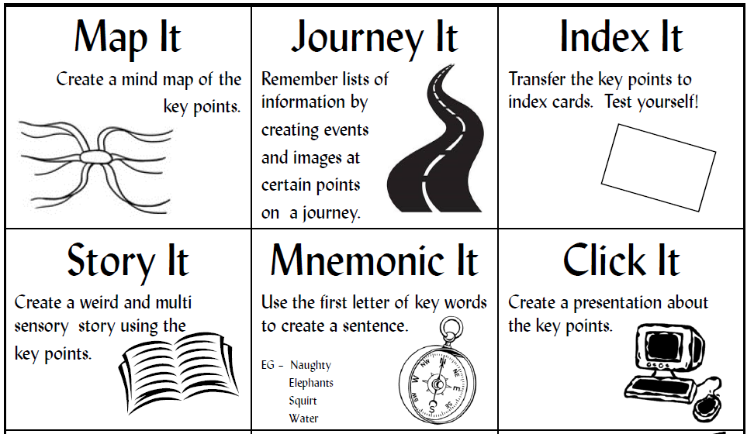
Just Do it
My 12 DIY Tips!
1
2
3
Use Different memory skills
4
5
6

Slide 21
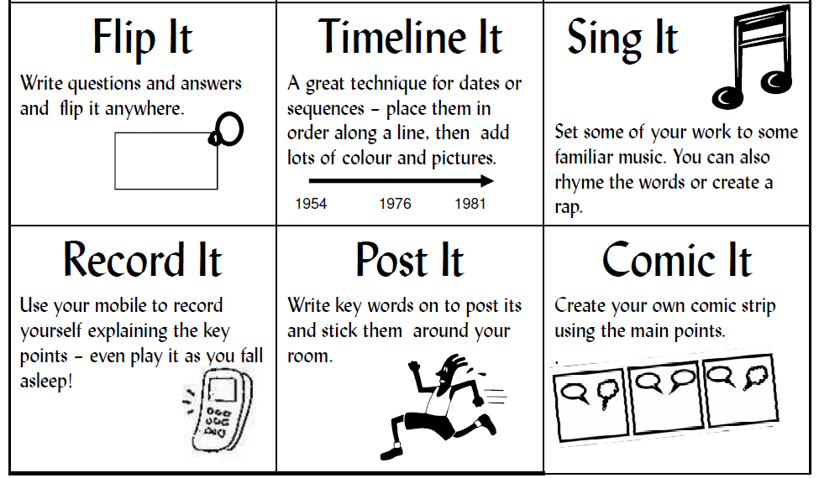
Just Do it
My 12 DIY Tips!
7
8
9
Use Different memory skills
10
11
12

Slide 22
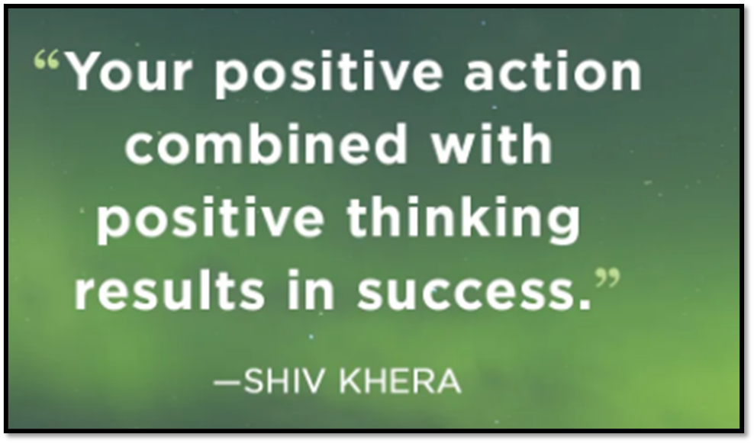
Good luck!

